Slide 1




Department of Engineering for Innovation Master of Science Degree in Computer Engineering
Performance Analysis of the Algorand Technology on low-power devices based on STM32 MPU
Supervisors:
Prof. Luigi Patrono
Prof. Luca Mainetti
Student: Salvatore Corvaglia
Co-supervisors:
Eng. Antonio Vilei
Eng. Teodoro Montanaro
Academic Year 2019/2020

Slide 2
Motivations
Integration of IoT systems and Blockchain technologies with a specific focus on the application to low-power devices of one of the most promising existing Blockchains: Algorand
To demonstrate the applicability of Algorand to low-power devices this thesis was organized as follows:
Analysis of the Algorand Blockchain and of the State of the Art
Testbed's design and selection of devices for experiments: STM32MP157A-DK1 and Raspberry Pi 4 Model B
Configuration of the selected low-power devices to operate as Algorand nodes
Perform most important Algorand operations on selected devices, such as transaction addition
Performance analysis among all the tested low-power devices

Slide 3
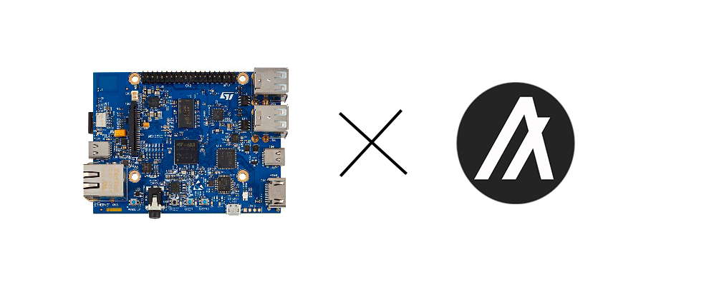
Objectives
For the purposes of this thesis the Algorand Blockchain has been selected for all the performed activities due to its inclination towards the IoT domain.
In fact, although Algorand propounds a bright horizon for financial purposes and lacks several features to be successfully applied to IoT networks, its characteristics are appealing for IoT.
This work has a high interest: a performance analysis on low power devices with Algorand technology has not yet been presented in literature.

Slide 4
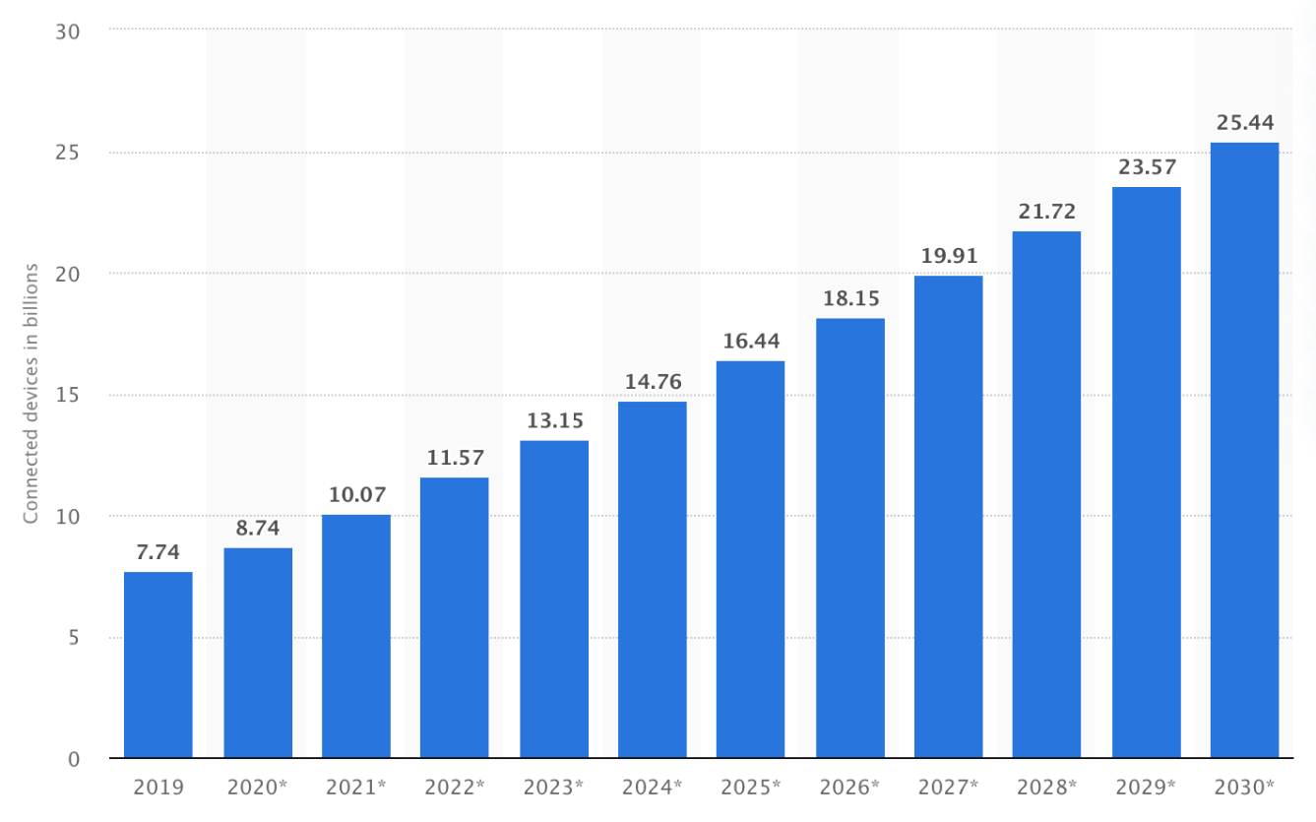
State of Art
A performance evaluation for Internet of Things based on Blockchain technology
Blockchain integration with low-power Internet of Things devices
Algorand alternatives:
Ethereum Blockchain-based IoT architecture used by low-power IoT devices
Implementation of secure IoT devices with IOTA and VeChain Blockchain

Slide 5
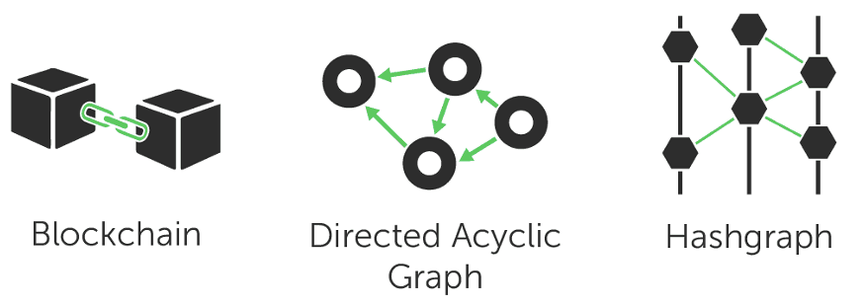
Distributed Ledger Technology

Slide 6
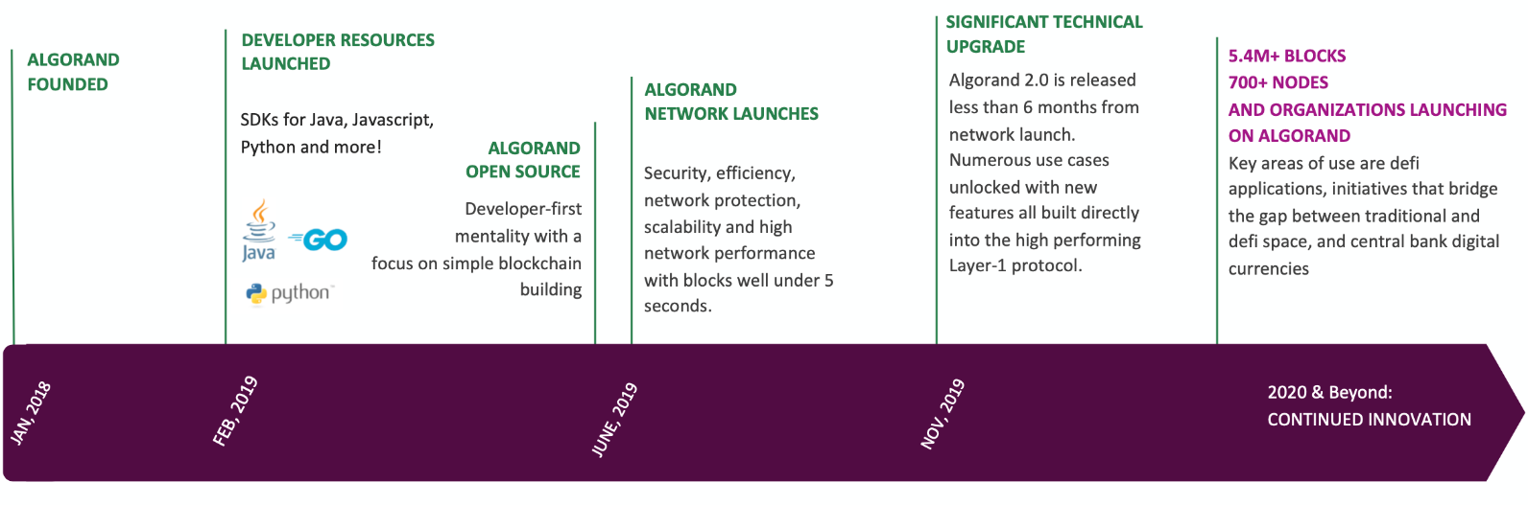
Algorand

Slide 7
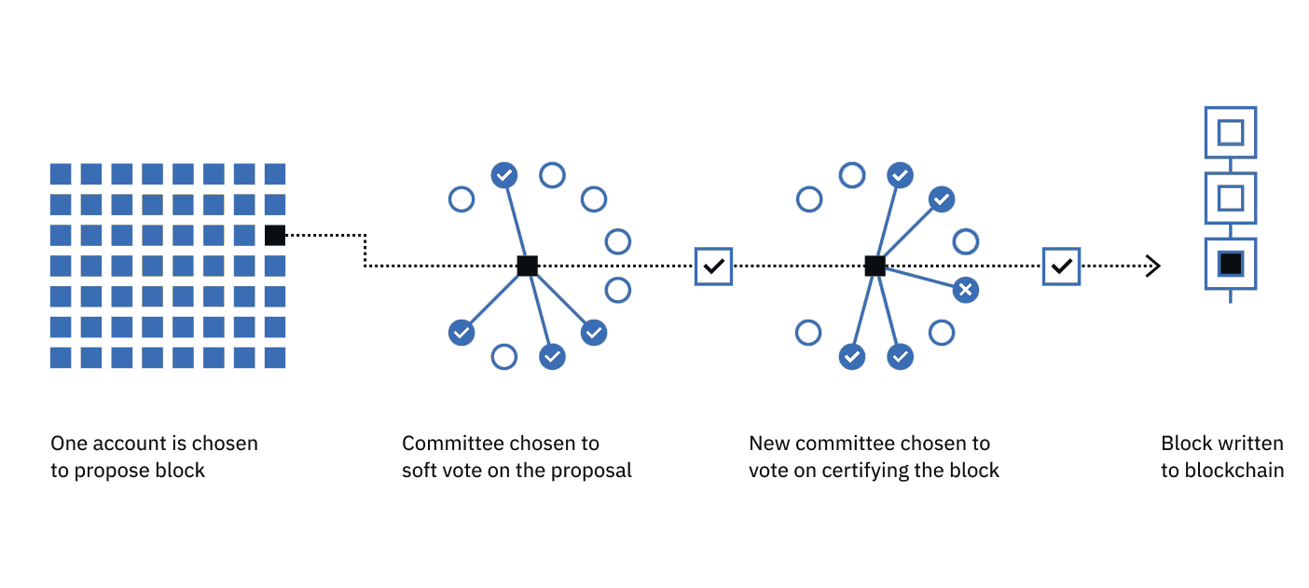
Algorand Consensus

Slide 8
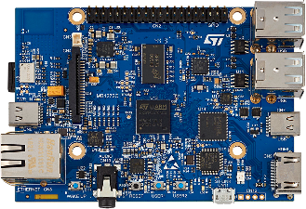
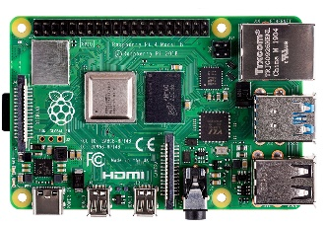
Proposed solution: testbed design
To test the applicability of Algorand to selected low-power devices, different operations have to be performed:
STM32MP157A-DK1
RASPBERRY PI 4 MODEL B
Synchronize Algorand Network
Perform write and read operations
Performance analysis

Slide 9
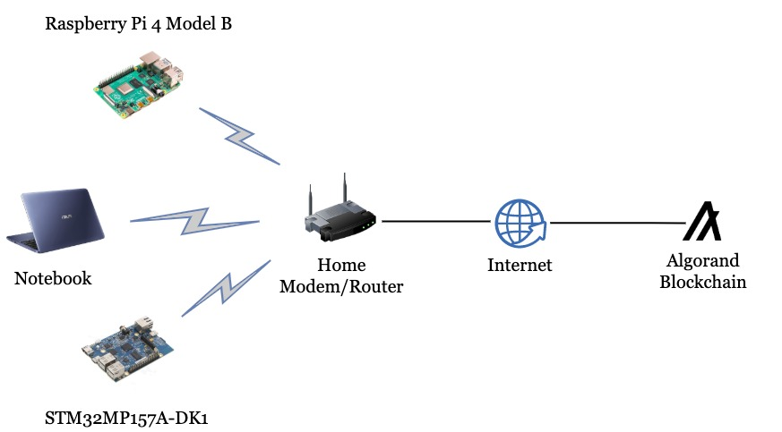
Proposed solution: performed operations

Slide 10
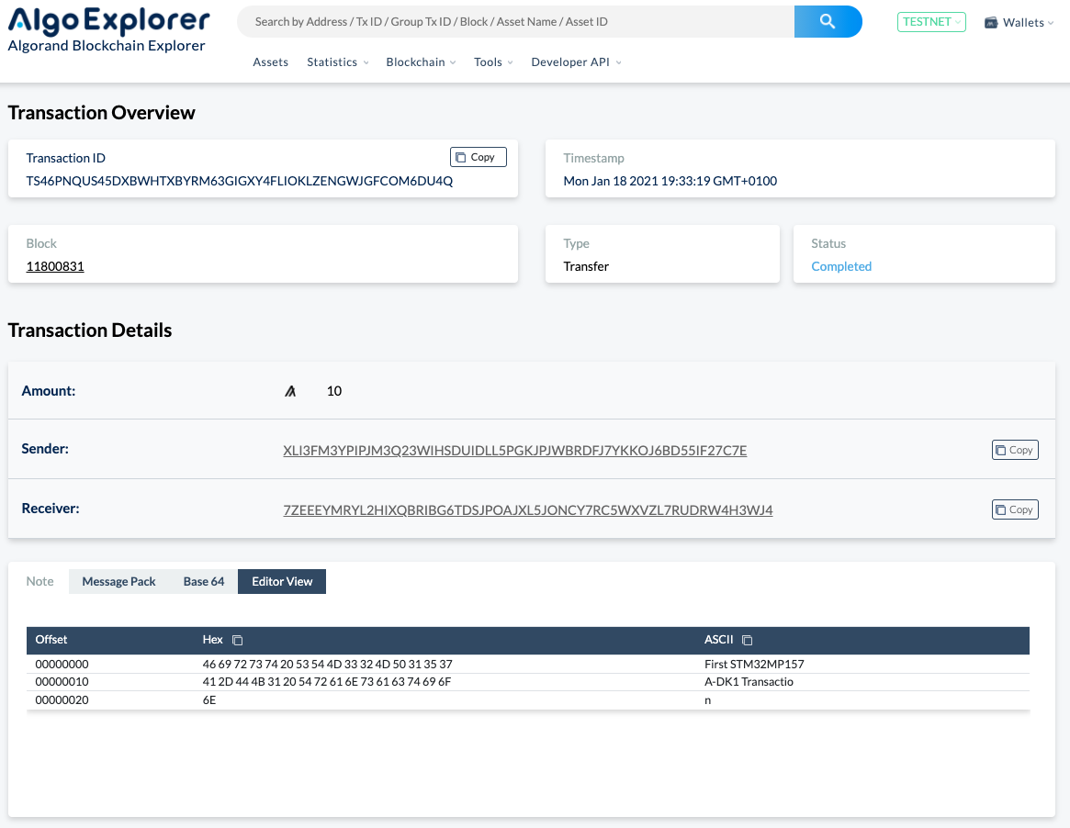
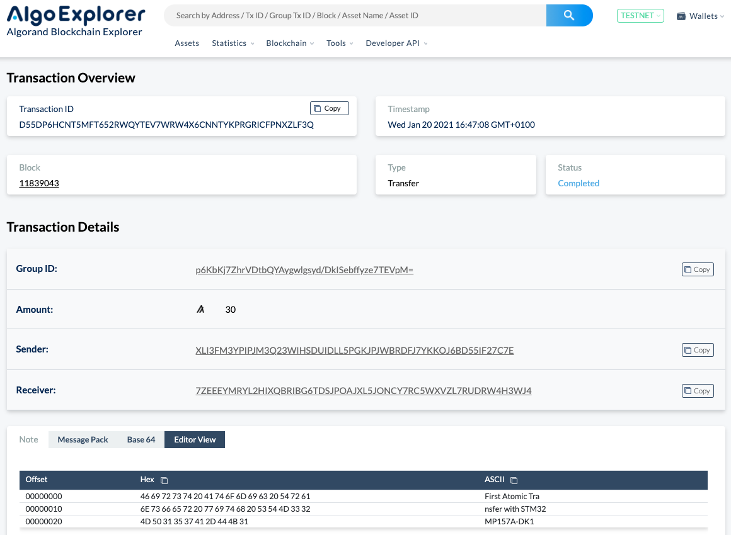
STM32MP157A-DK1 Results
Write and read operations
STM32MP157A-DK1 Transaction
STM32MP157A-DK1 Atomic Transfer

Slide 11
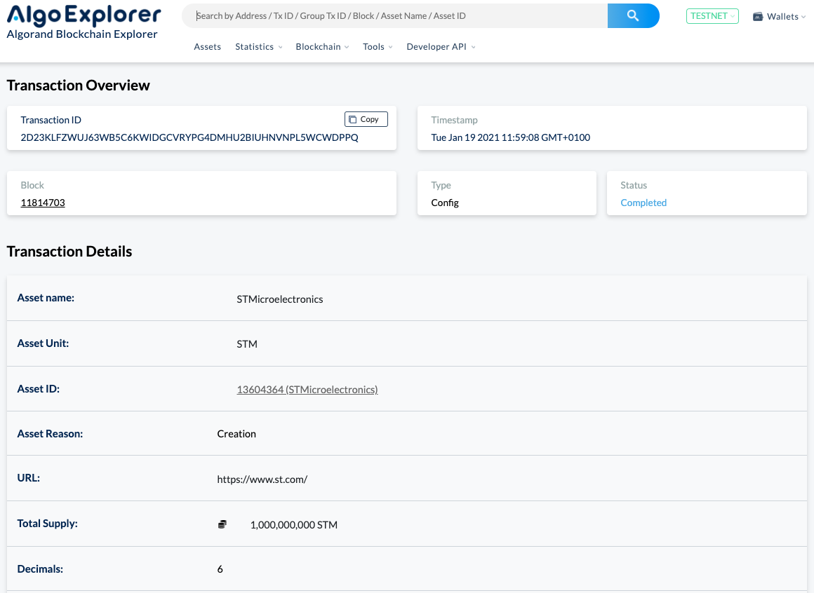
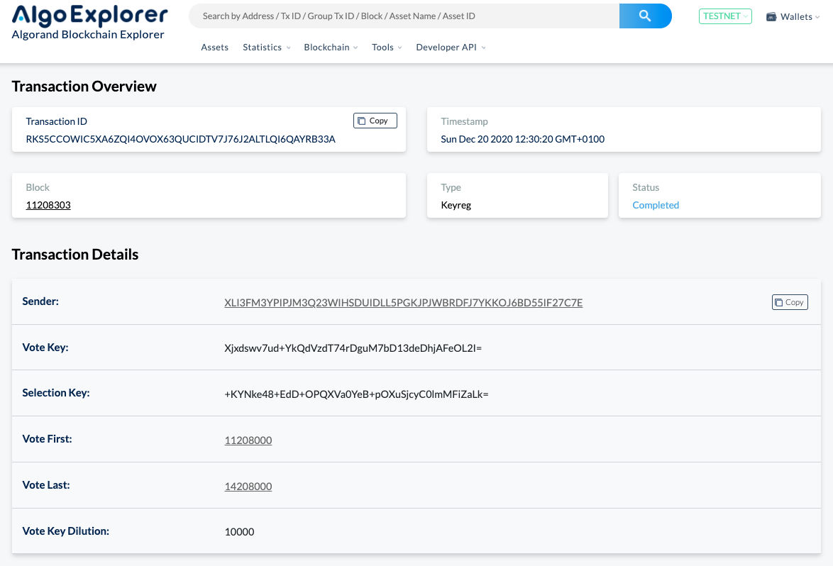
STM32MP157A-DK1 Results
Write and read operations
STMicroelectronics ASA
Key Registration Transaction

Slide 12
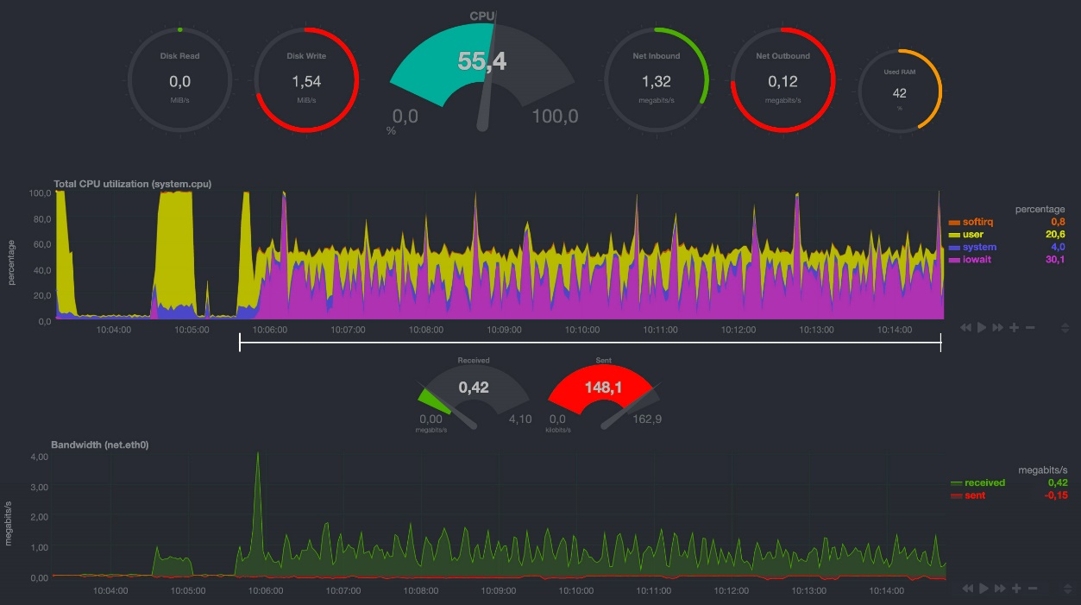
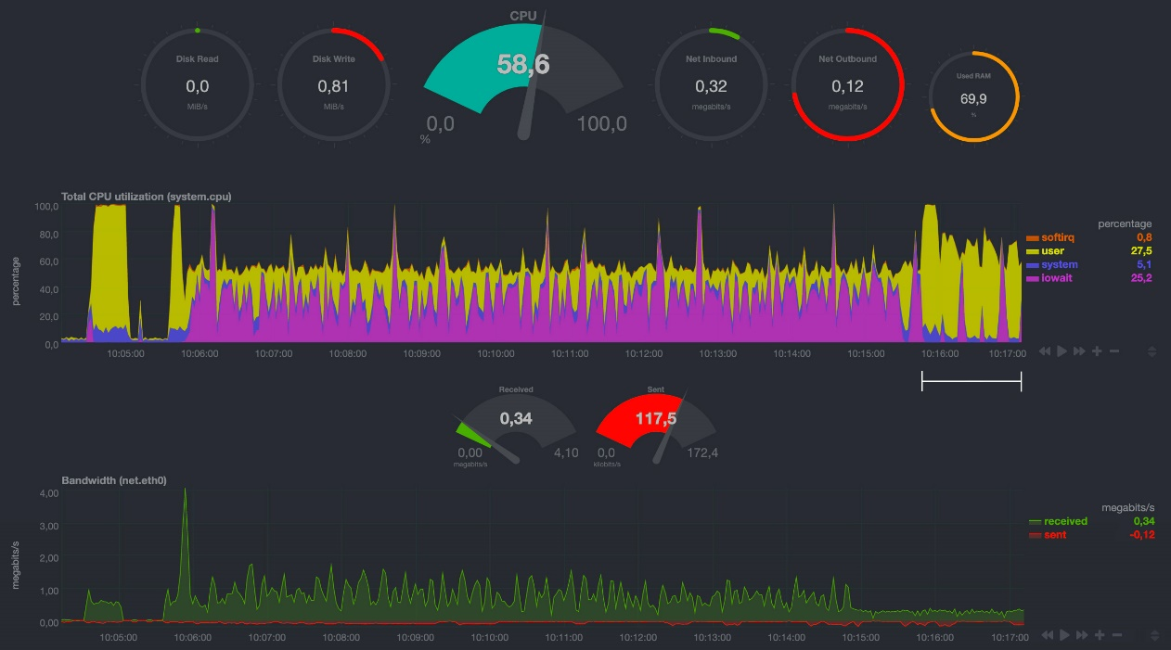
STM32MP157A-DK1 Results
Performance Analysis
Phase 1 STM32 node synchronization
Phase 2 STM32 node synchronization

Slide 13
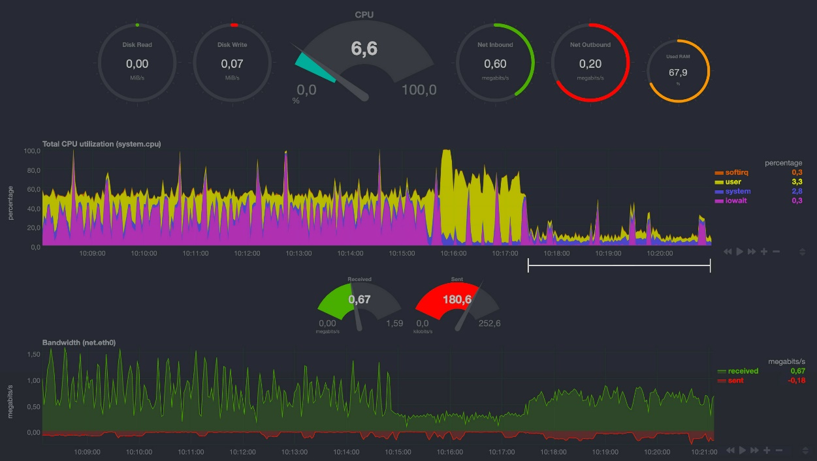
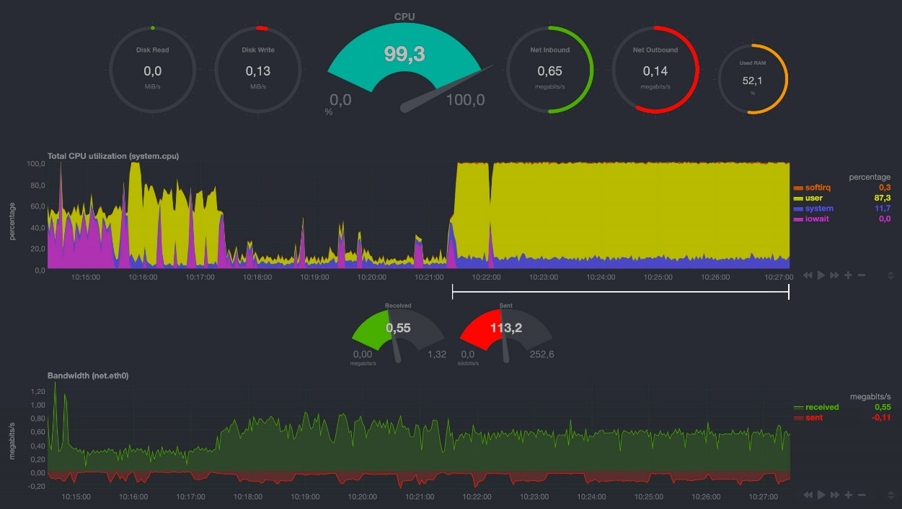
STM32MP157A-DK1 Results
Performance Analysis
Phase 3 STM32 node synchronization
Phase 4 STM32 node synchronization

Slide 14
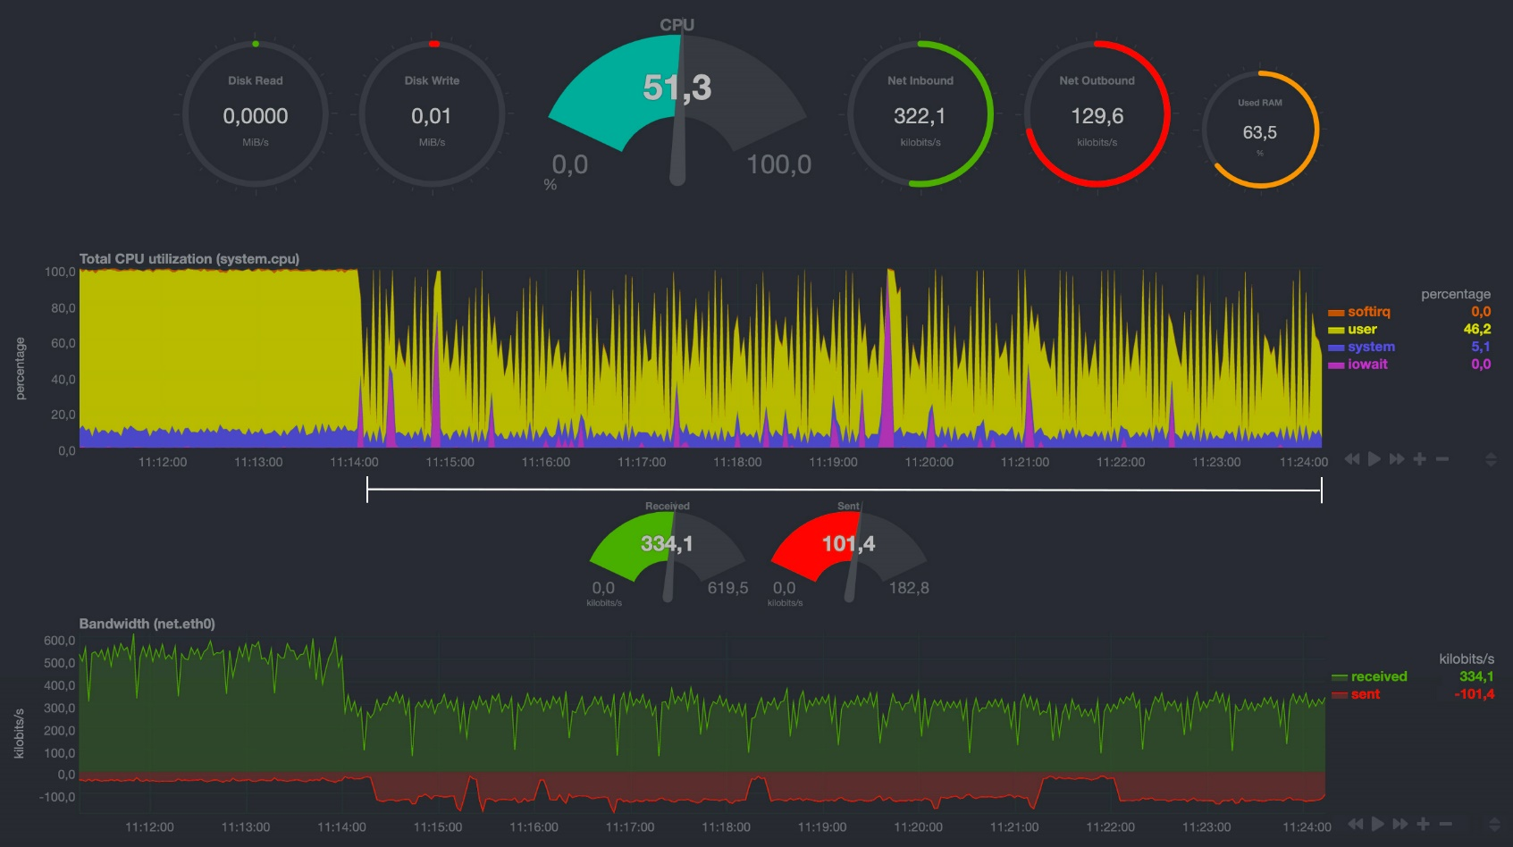
STM32MP157A-DK1 Results
Performance Analysis
Phase 5 STM32 synchronized node

Slide 15
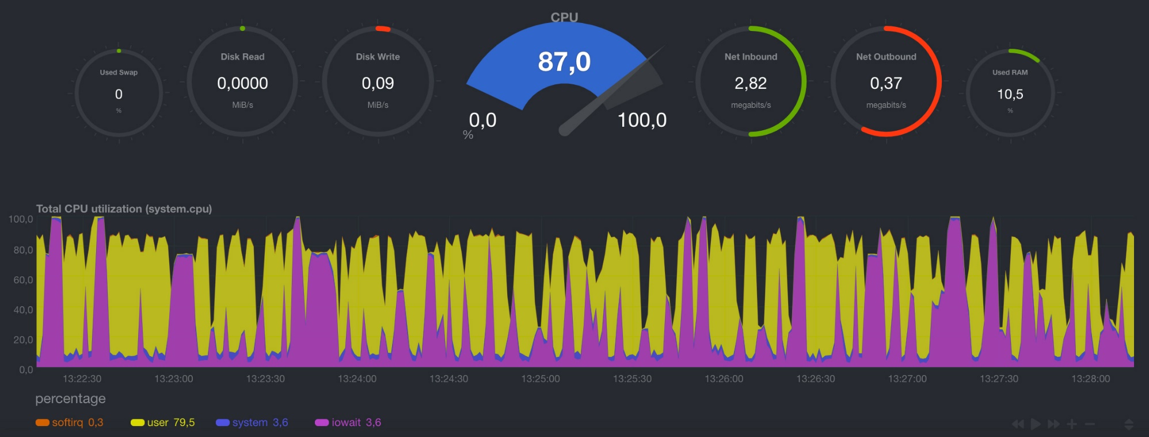
Raspberry Pi 4 Model B Results
Performance Analysis
Phase 4 Raspberry node synchronization

Slide 16
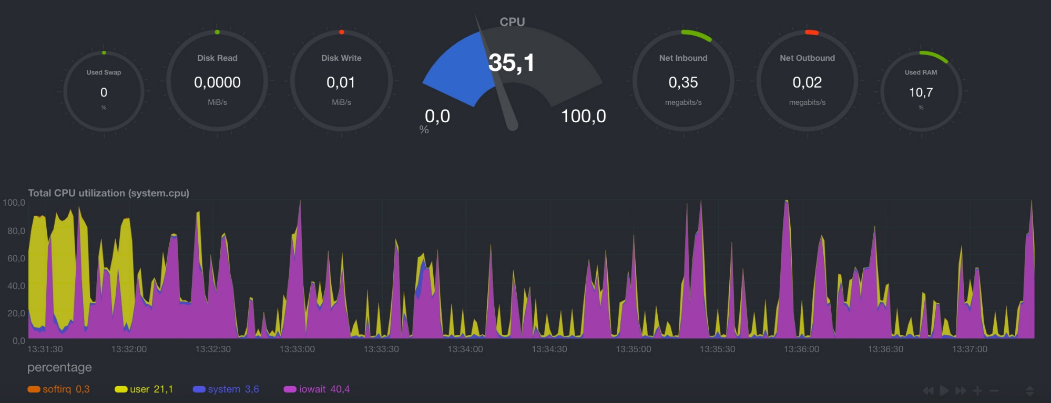
Raspberry Pi 4 Model B Results
Performance Analysis
Phase 5 Raspberry synchronized node

Slide 17
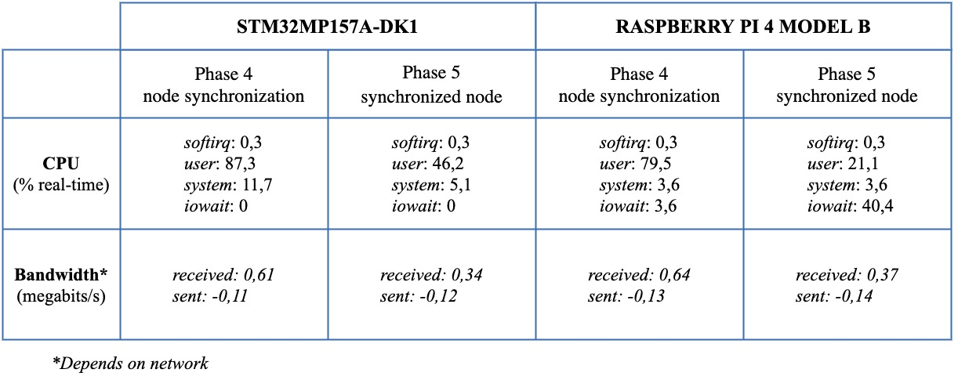
Results

Slide 18
Conclusions and future works
Applicability of the Algorand Blockchain on low-power devices was demonstrated
STMicroelectronics device is suitable for joining the Algorand network and capable of publishing transactions to the Algorand Blockchain in a few seconds and running some of its functions
Comparison among the exploitation of various Blockchains on IoT low-power devices
Implementation of interesting use cases that could exploit smart contracts for their purposes
Development of a basic C library for Algorand to be used on constrained low-cost devices based on MCU, like STMicroelectronics’ STM32 (Cortex-M Architecture)
Performance analysis on the Algorand Mainnet Network
A scientific paper will be submitted in May to an International Conference

Slide 19


Salvatore Corvaglia
Algorand Developer Ambassador

Slide 20
Thank you for your attention!

